Slide 1
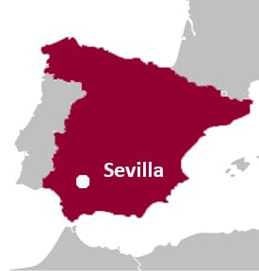

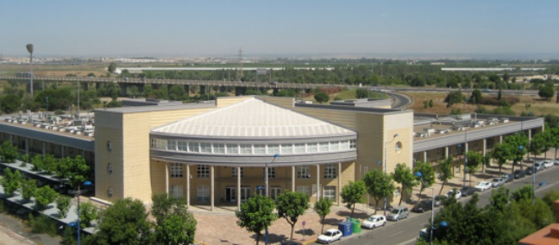

A. Fernández*, D. Hufschmidt, M.C. Jiménez de Haro.
Materials Science Institute of Seville, CSIC-Univ. Seville
“From a material developed for the control of optical properties to innovative helium targets´ fabrication for fundamental studies of nuclear reactions”
Number: 3
Presentation Type: Oral
Symp : GEFN - Simposio de Física Nuclear
12 + 3 min

Slide 2
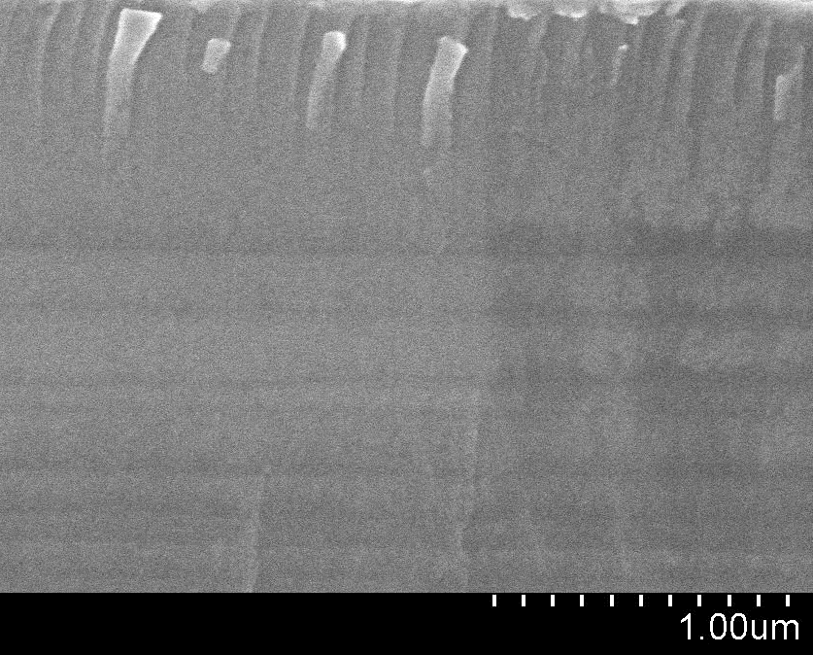
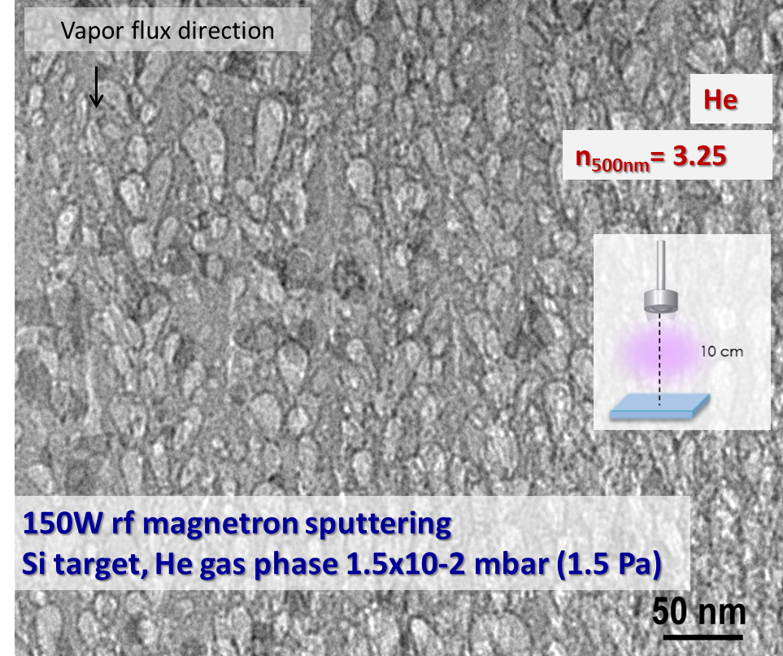
1st objective: To improve the efficiency of Silicon based solar cells.
Our goal: To develop antireflective coatings based on porous silicon deposited onto silicon wafers. The porosity would reduce the refractive index
1st results: We found that nano-porous silicon films can be obtained by magnetron sputtering (MS) deposition in helium plasma. The required reduction of refractive index was achieved.
Two deposition conditions during magnetron sputtering deposition of Si:
Ar + biass
n_{500nm}= 4.75
150W rf magnetron sputtering
Si target, Ar gas phase 1.5 Pa + substrate biass

Slide 3
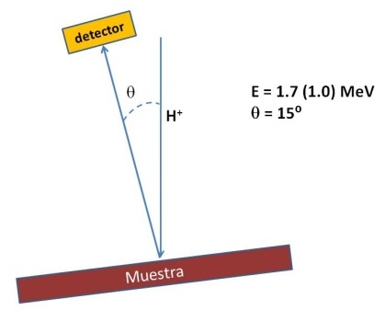
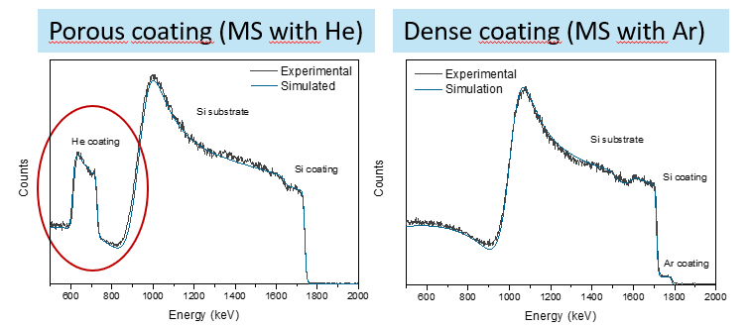
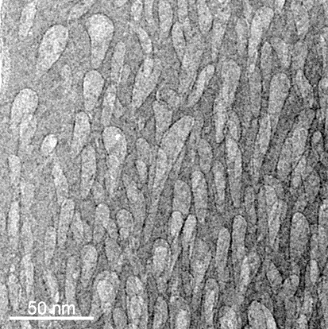
The quantification of the coatings by P-EBS measurements
P-EBS Performed with 1.7 MeV protons and a solid state detector located at 165° scattering angle at the CNA in Seville. High amount of He homogeneously distributed in depth for the Si films growth by MS with He as process gas
Sample | thickness (10¹⁵at/cm²) | Si (%at) | He (%at) | Ar (%at)
porous | 11000 | 78.7 | 21.3 | --
dense | 9500 | 92.0 | -- | 6.0
Where is He?--Inside the pores? Dispersed?
TEM-EELS
(Transmission Electron Microscopy (TEM)
coupled to
Elelectron Energy Loss Spectrocopy (EELS)

Slide 4
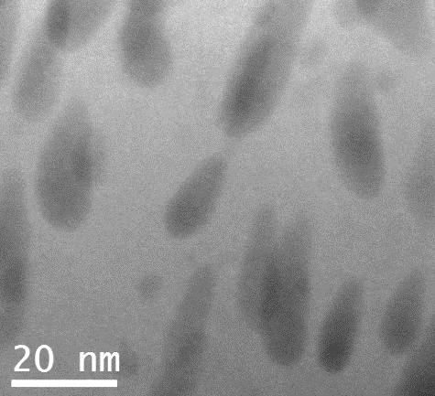
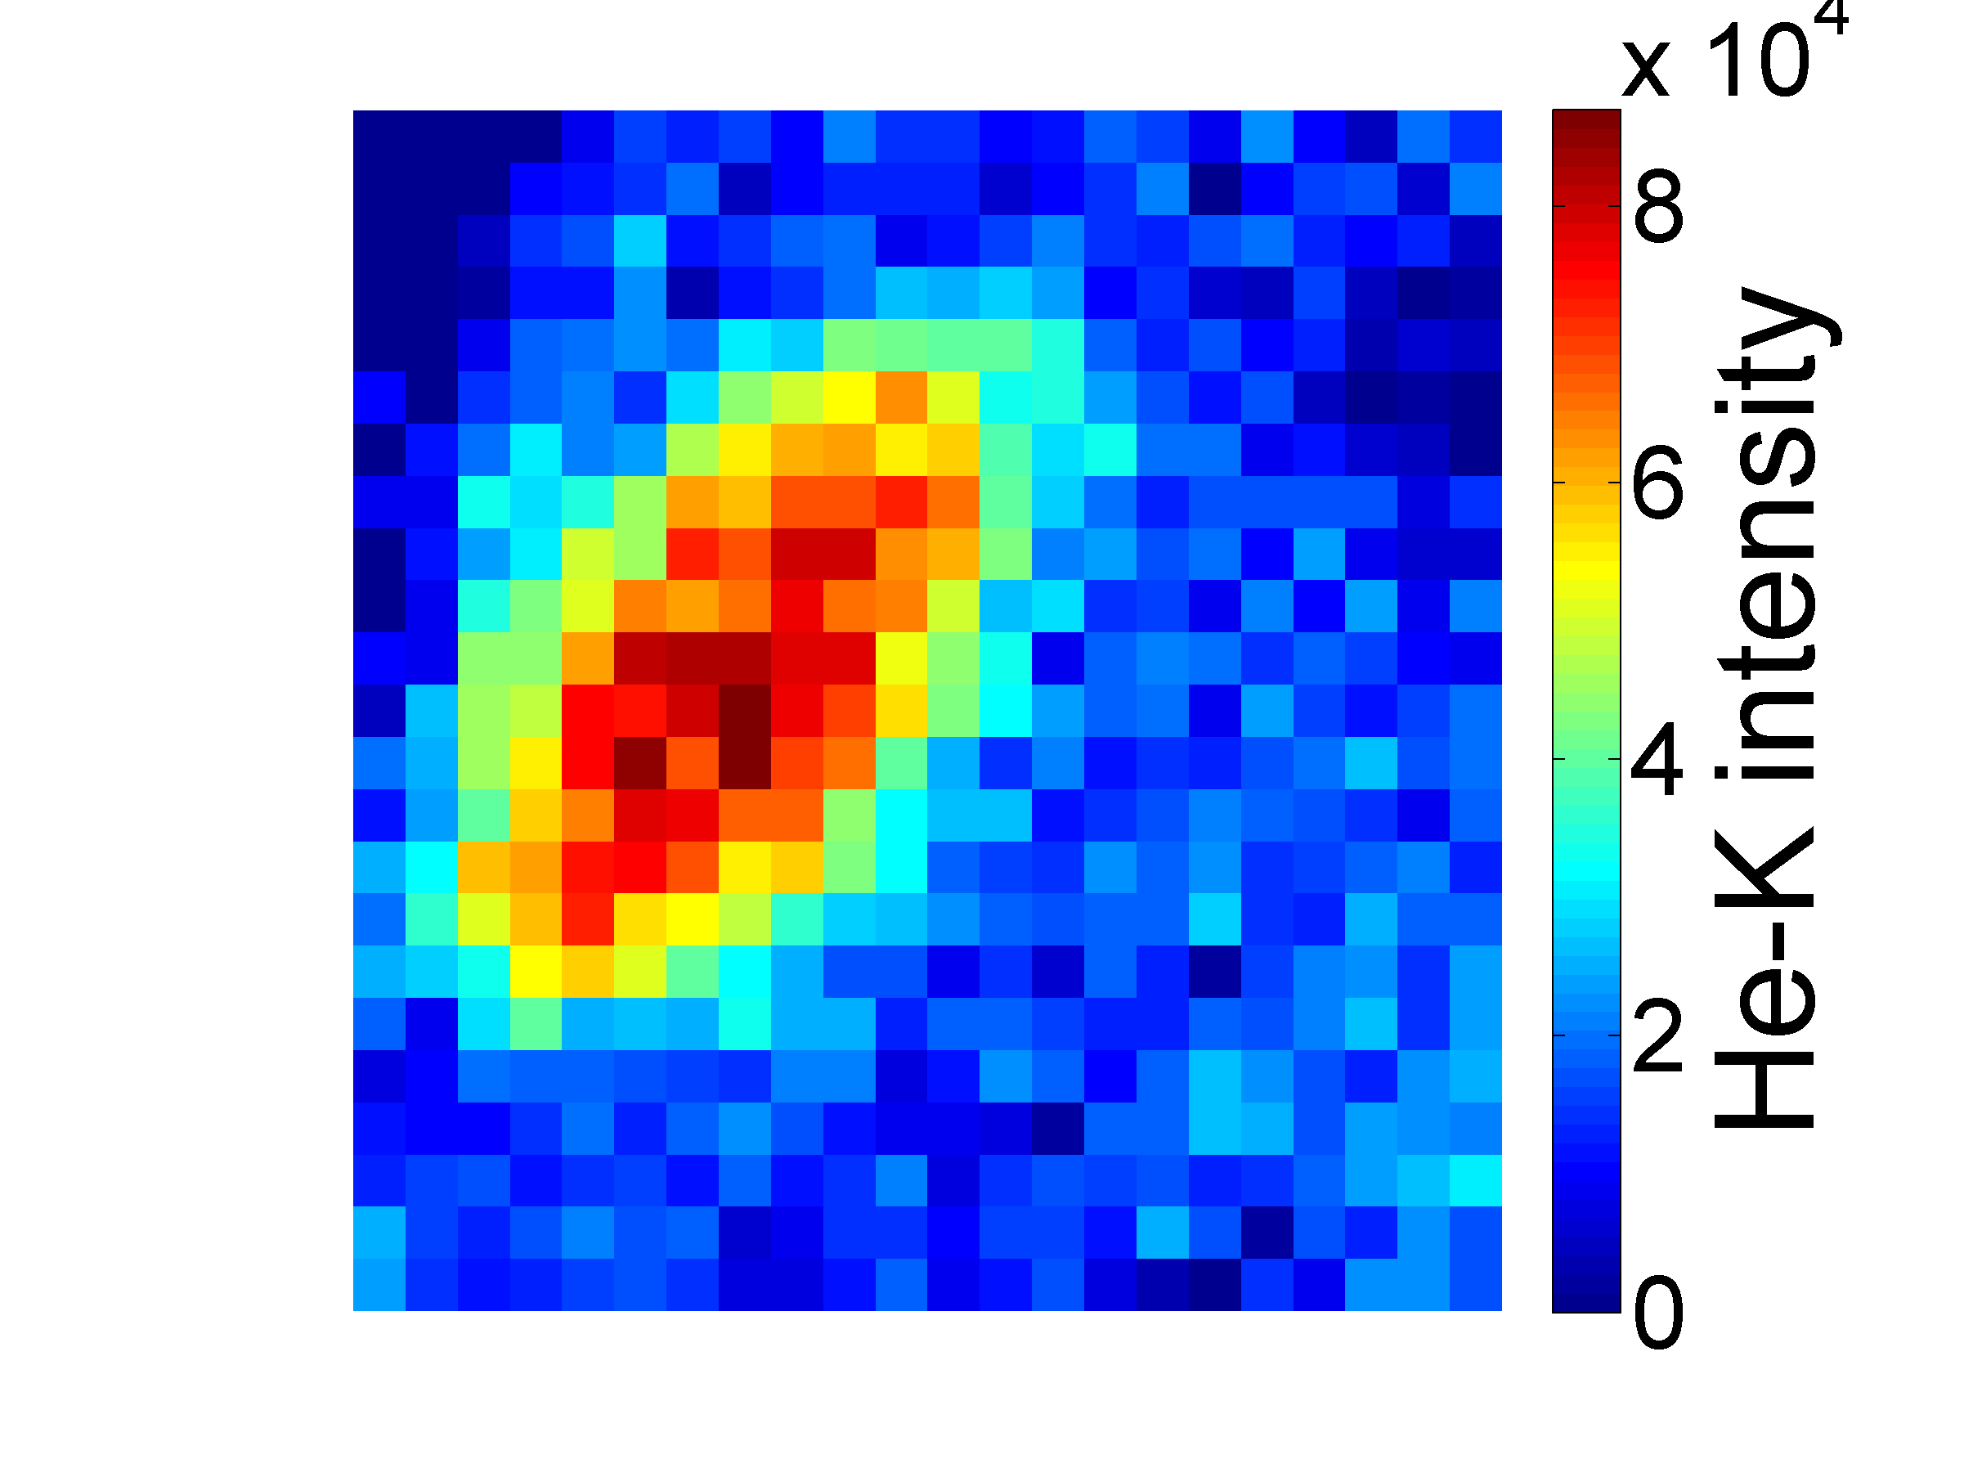
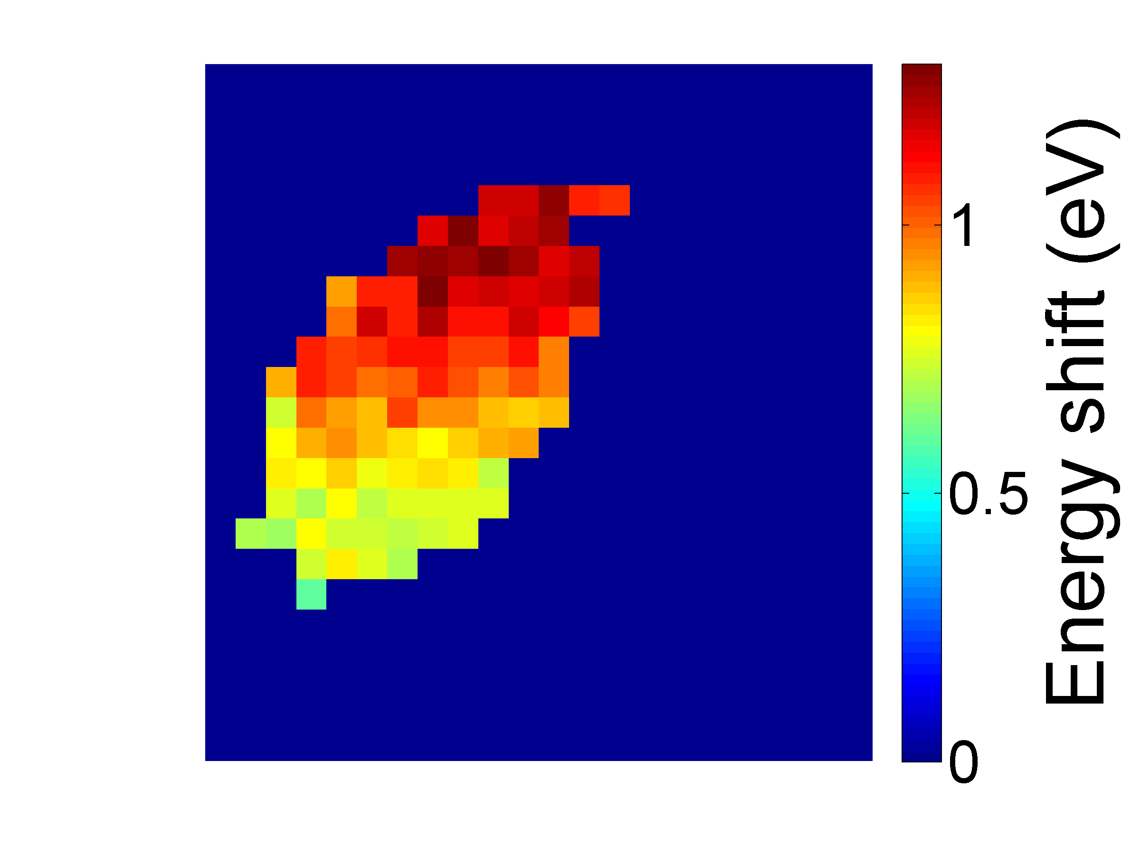
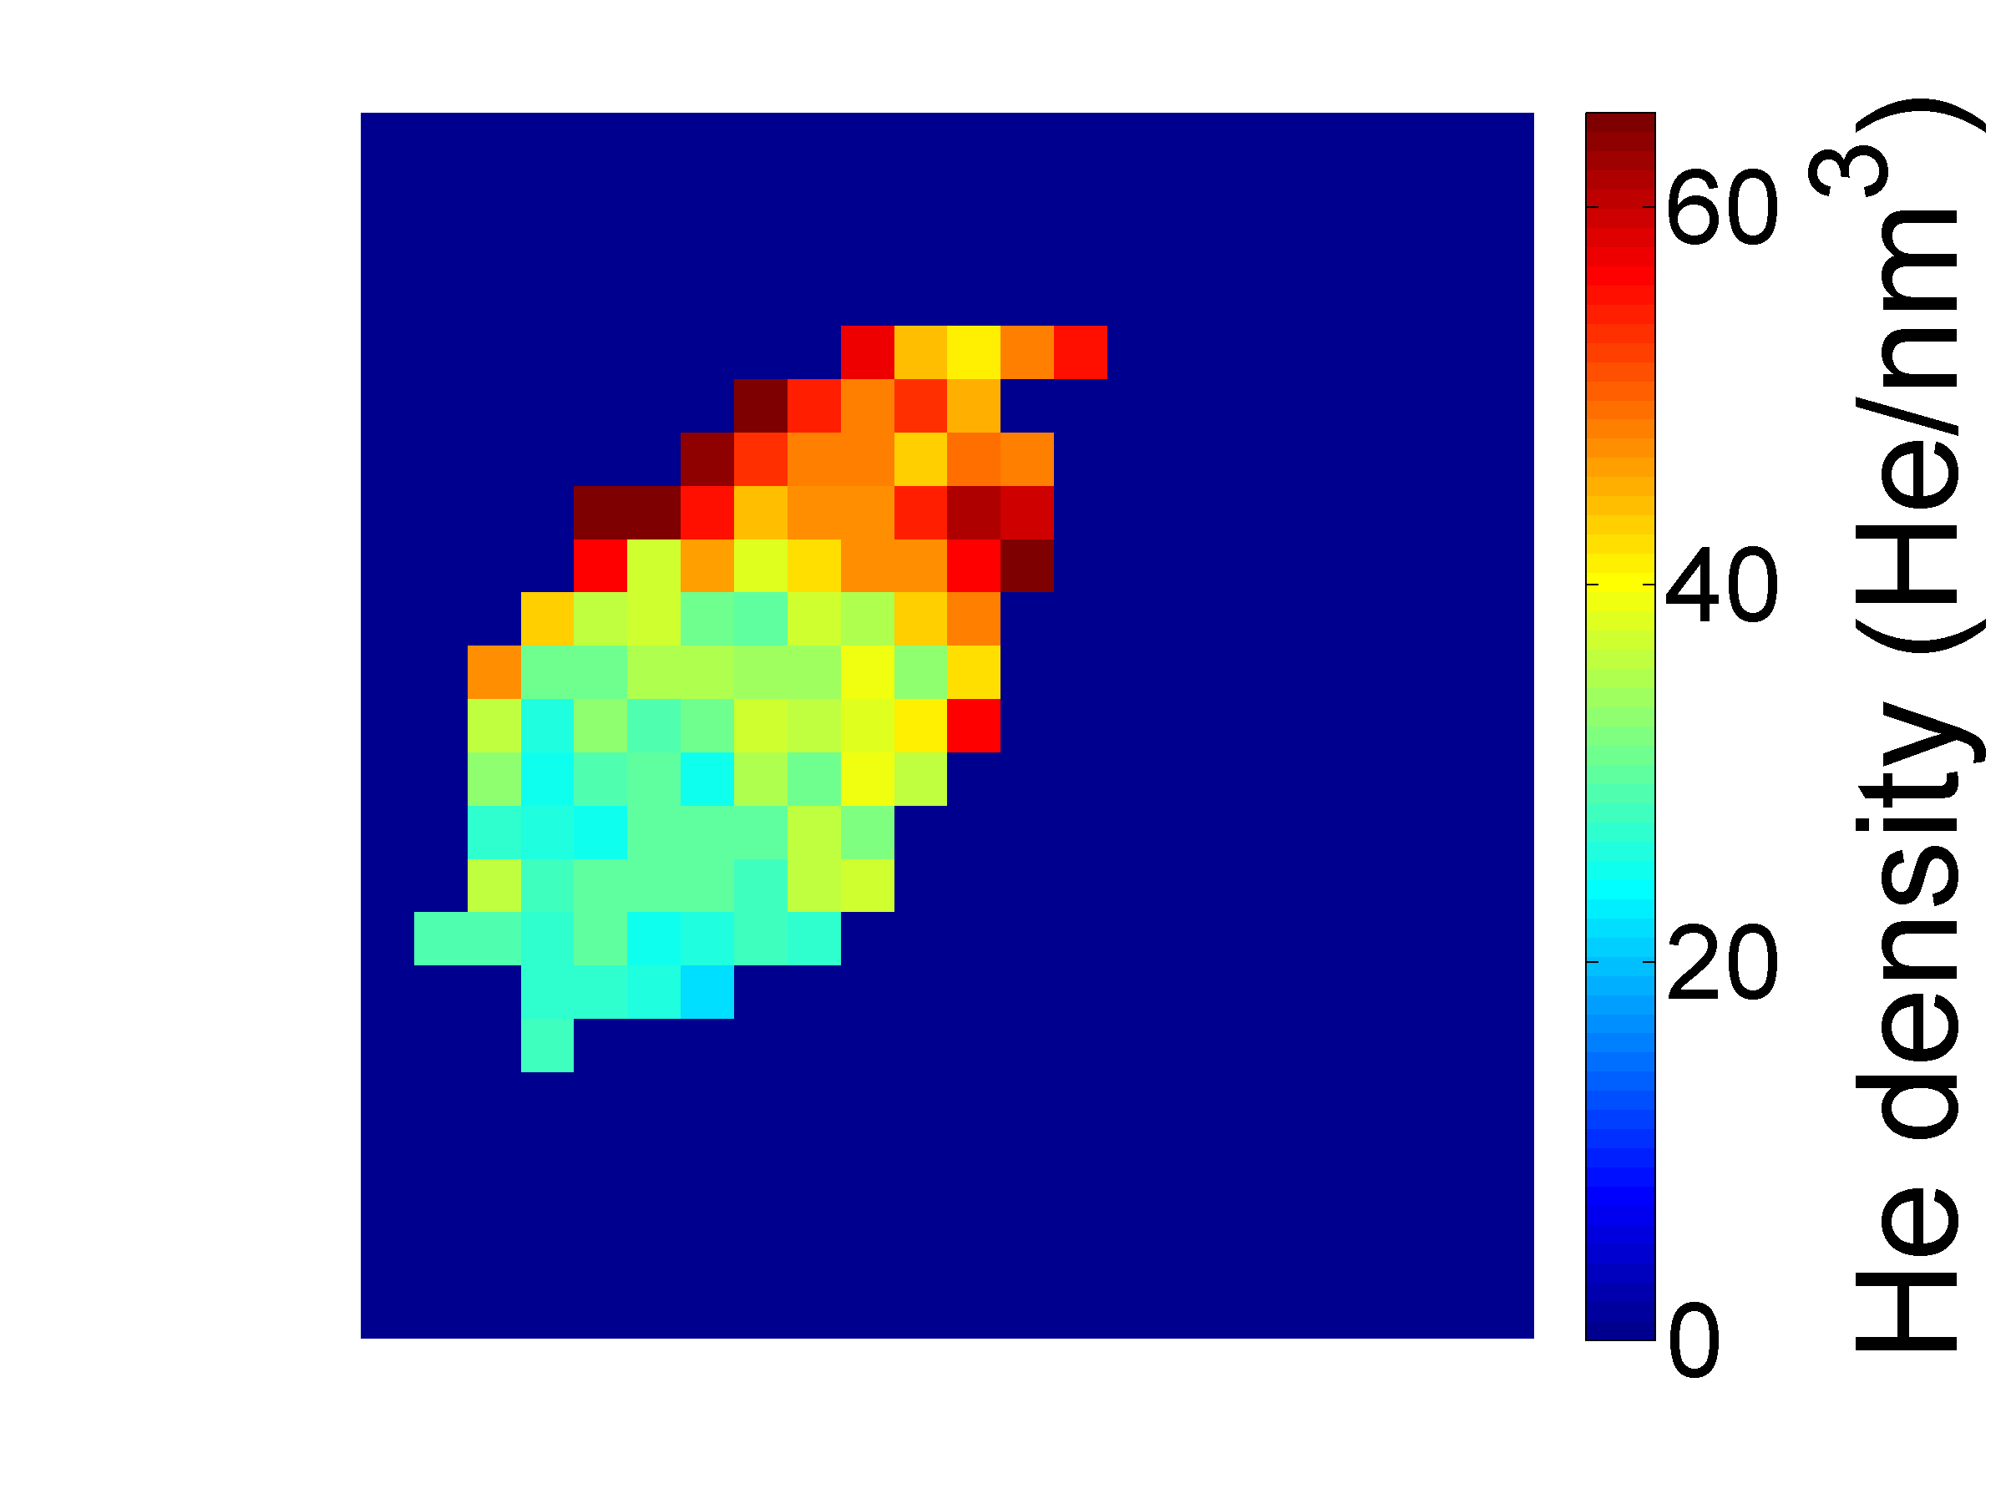
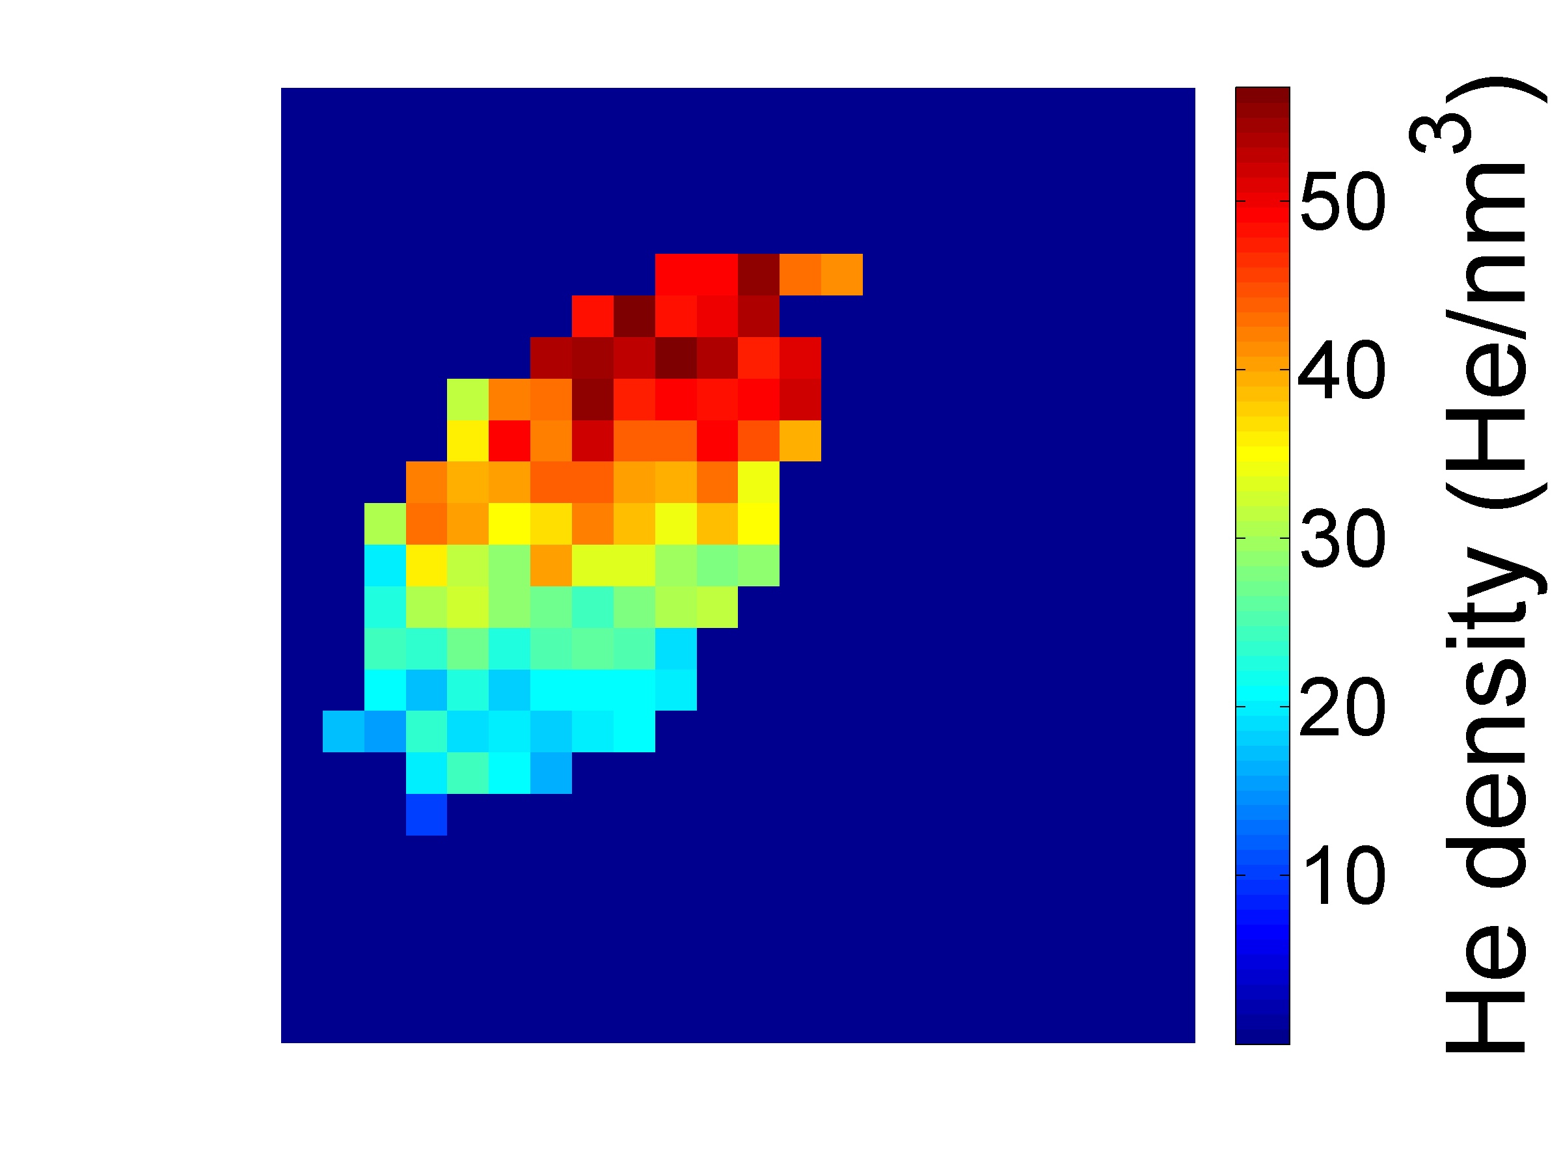
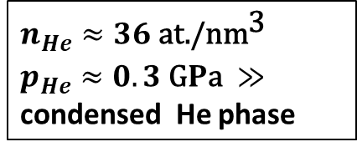
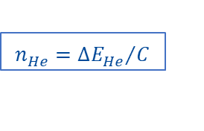

TEM microscopy for Helium localization in porous Si
Intensity map I_{He}
Energy shift map ΔE_{He}
STEM-HAADF
( Z-contrast )
Intensity proportional to Z²
Pores are darker than the matrix
Isolated pore
$$n_{He}^{}=\frac{I_{He}^{}}{I_{ZLP}^{}}\frac{1}{σ_{He} h}$$
$$n_{He}^{}={{∆E}_{He}^{}}/C$$
The IBA and TEM-EELS Microscopy) techniques showed that the growth by magnetron sputtering allows to develop homogeneous He charged thin films of several microns. The technique is versatile and easier up scaling. Alternative/complementary methodology to implantation.
Helium density maps n_{He}
Quantification of individual pores
$$n_{He}^{}≈36 \text{at}\text{./}{\text{nm}}^{\text{3}}$$
$p_{He}^{}≈0.3 \text{G}P\text{a} ≫$ condensed He phase
Low Loss Helium
K-Edge region Quantification of the Electron Energy Loss (EELS) spectra.

Slide 5
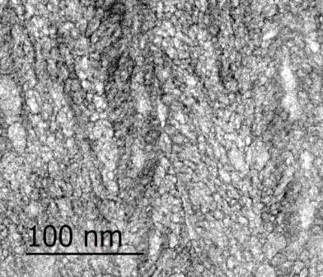
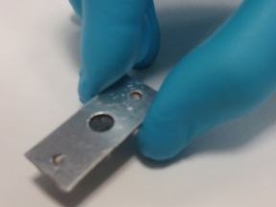
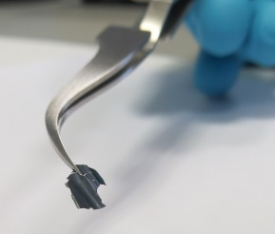
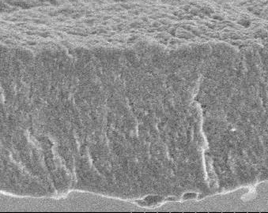
IBA analysis: He solid targets /self-supported films
As deposited
3 months stored
2 years stored
TEM image
P-EBS of an a-Si:He self-supported thin film.
P-EBS of an a-Si:He thin film grown on a Si support. High stability over time.
Irradiation with 2.5 MeV proton beam
We propose to test and validate the materials first as standard for ion beam assisted analysis techniques (IBA). We achieved up to 40 at% He content in Si. Stability during use seems to be good. We need to reduce the content of possibly impurities like O, C, N or H
SEM image
1 µm

Slide 6
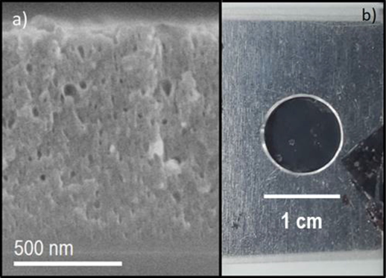
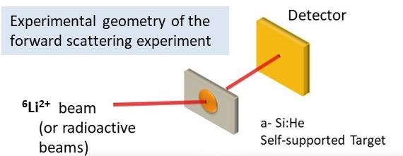
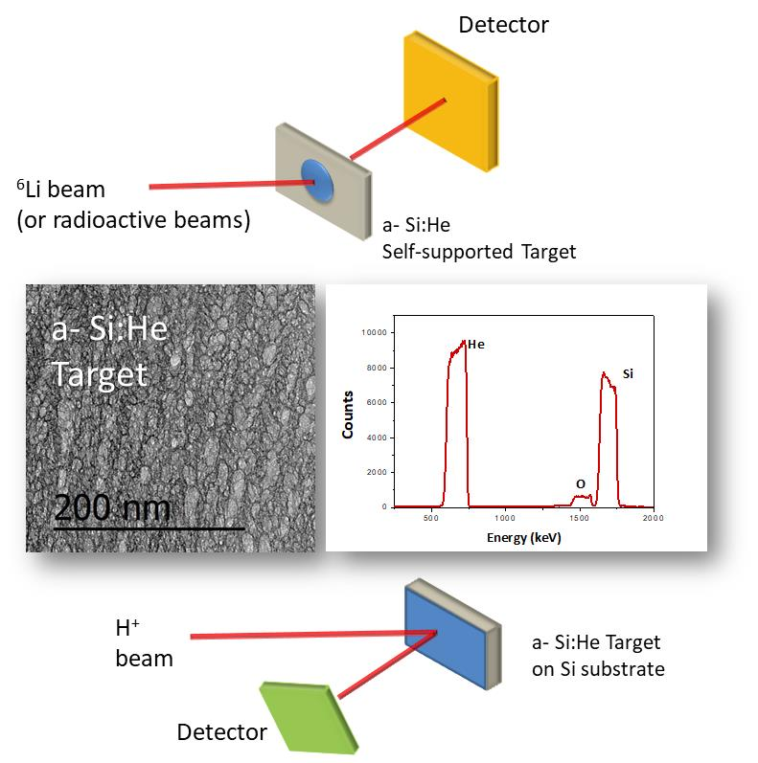
Solid-gas nanocomposite films as targets for nuclear reactions studies
● He targets were typically based on cryogenic systems or gas chambers.
No accessible He compounds.
●Thin film are easy to handle reducing energy straggling and simplifying geometry for calculations. We achieved 40 at% He content in Si and E18 at/cm2 in 1-3 µm thick films.
(1) Elastic scattering cross section determination.
(2) The study of nuclear properties of radioactive nuclei by Inverse Kinematics. The radioactive ion beam (short lifetime) is irradiating a Helium target.
First tests started with stable beams
Radioactive beam

Slide 7
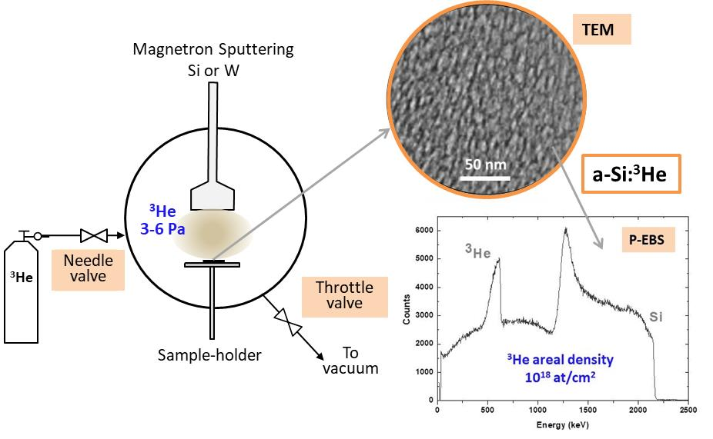
Layers with ³He trapped
a-Si:3He or W:3He
Low gas consumption methodology.
● We operated the MS deposition in a quasistatic regime to avoid ³He consumption
3He is a very interesting isotope for nuclear reactions studies and detectors. It is however scarce in our atmosphere and therefore very expensive. The MS methodology needed to be adapted for this particular case. We achieved up to 30 at% 3-He content in Si.

Slide 8
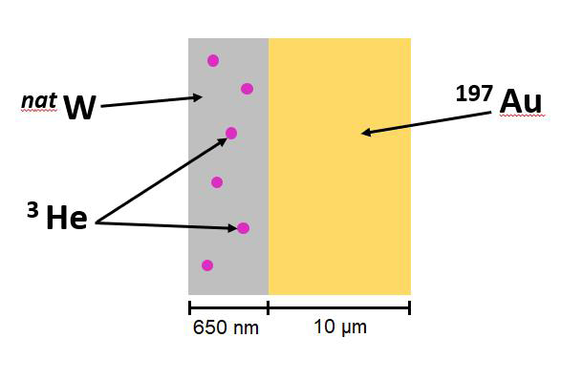
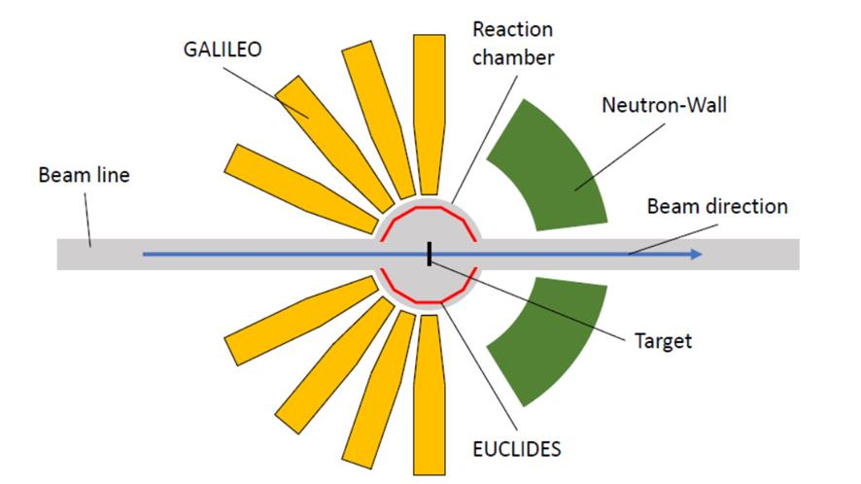
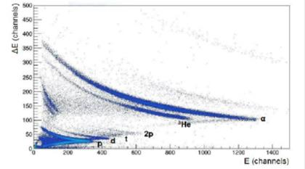
Test for a ³He solid – inverse kinematic
target stability
INFN-LNL Legnaro J.J. Valiente, IFIC-CSIC A. Gadea
Reaction for test: ⁶⁴Zn(³He,n)⁶⁶Ge
W:³He on a gold foil
Beam: ⁶⁴Zn at 275 MeV
Intensity: 0.5-5 pnA. Duration: 22hours
The ³He was expelled out of the target due to the scattering with the ⁶⁴Zn probe beam and was detected in the ΔE-E telescopes (the Euclides detector).
³He

Slide 9
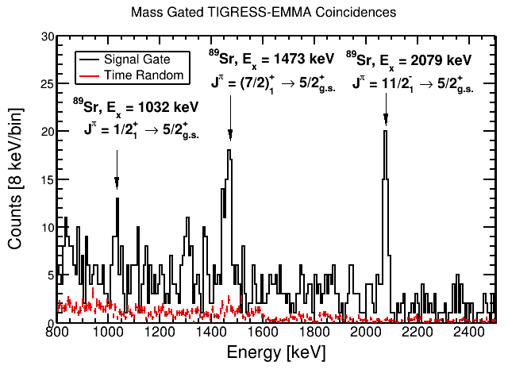
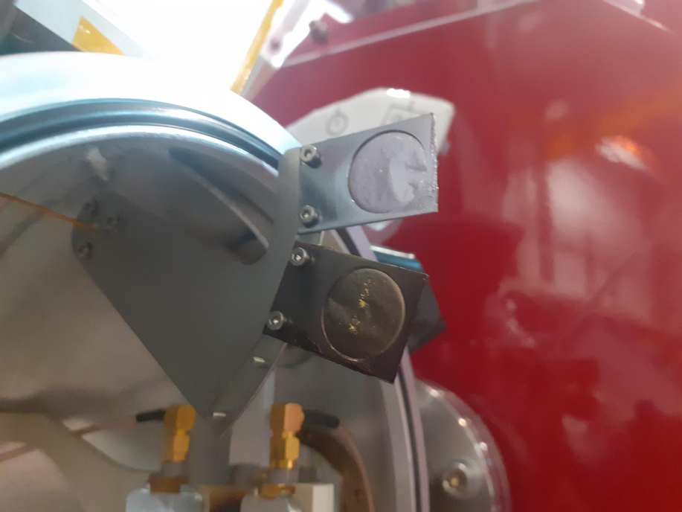
Experiments nr. S2037 at TRIUMF-EMMA – August 2022.
The radioactive 94Sr beam not available. Irradiation with the stable 86Kr
The gamma rays from the de-excitation of the 89Sr show that this nucleus was populated in the ⁸⁶Kr(α,n)⁸⁹Sr reaction.
Measurement of the 86Kr(𝜶,n)89Sr cross section
at energies relevant for the weak r-process
EPJ Web of Conferences 279, 11003 (2023) NPA-X 2022. https://doi.org/10.1051/epjconf/202327911003

Slide 10
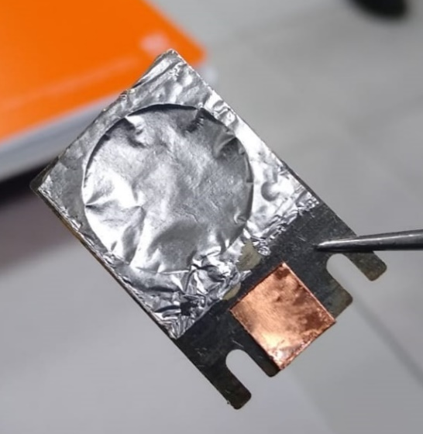
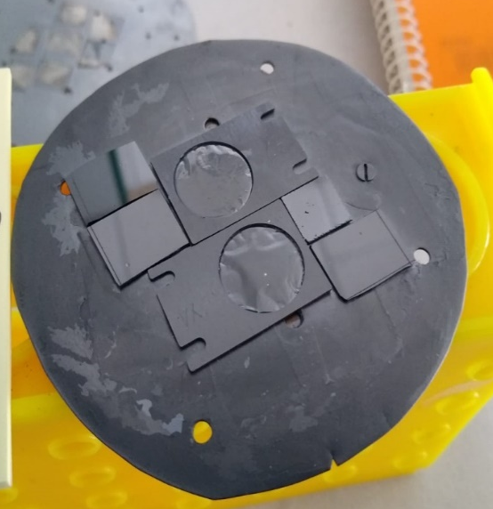
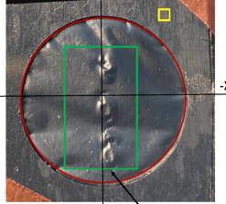
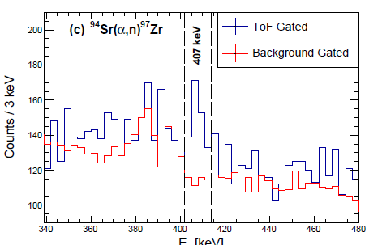
Experiments nr. S2037 at TRIUMF-EMMA – December 2023.
Irradiation with the radioactive 94Sr
The gamma rays from the de-excitation of the 97Zr show that this nucleus was populated in the 94Sr(α,n)97Zr reaction. The He content could be monitored during the experiments. Initial He contents reached 6-8xE18 atoms/cm²
Received from TRIUMF
Fabrication at ICMS
Used target at TRIUMF
Backed targets. Colaboration with Univ York-UK and TRIUMF facility (Canada)
Si:He (3.2 microns) onto Al backing (8 microns). Exp. PI (A. Laird)
Back side. Backing Al foil
Front side. Si-He film
Front side. Si-He film
First measurement of a weak r-process reaction on a radioactive nucleus
M. Williams,1, ∗ C. Angus,2, 3 A.M. Laird,3, 2 B. Davids,2, 4 C. Aa. Diget,3 A. Fernandez,5 E. J. Williams,2. et all. PHYSICAL REVIEW LETTERS 134, 112701 (2025). DOI: 0031-9007/25/134(11)/112701(7)

Slide 11





Thanks to financed projects
MINECO (Project CTQ2015-65918-R)
MICIU (Project RTI2018-093871-B-I00
MINECO (Project PID2021-124439NB-I00
Ref.: PIE 202160E029
Ref.: PIE 201760E002
Ref.: PIE 201460E018
Ref.:
P20_00239
Ref.:
PRX 18/0052
LE STUDIUM RESEARCH FELLOW, Loire Valley Institute for Advanced Studies Orléans & Tours France

Slide 12



Thanks to colaborations
NanoMatMicro - LANE
ICMS- CSIC-Seville
● V. Godinho
● J. Caballero
● D. Hufschmidt
● D. Feria
● R. Schierholz
● B. Lacroix
● M.C. Jiménez
● O. Montes
● I. Rosa
Coatings development
IBA and PAS characterization
CEMTHI-CNRS Orléans
● T. Sauvage ● B. Diallo
● P. Desgardin ● M.-F. Barthe
Simulation and IBA
LARN-Univ. Namur
● S. Lucas
● J. Colaux
● P. Moskovkin
Advanced TEM
Electron microscopy
Nuclear Reactions
Univ. York-TRIUMF-Univ. Surrey
●A. Laird ● M.Williams ● C.Diget
Univ. Birmingham
● C. Wheldon
CNRS-IN2P3-Univ. Paris-Sud
● N. de Sereville ● M. Assié
Simulation
ICMS- CSIC-Seville
● A. Palmero
● R. Álvarez
EELS Theory: Univ.Old Unium(USA) Univ. Cambrige (UK)
● C. Whelam ● N. Pyper ● A. Thom
IBA-Nuclear Reactions
CNA-Univ. Seville
● F.J. Ferrer
● J. Gómez
● B. Fernández
Nuclear Reactions
LIP-Univ. Lisboa
● D. Galaviz
● F.G. Barba
Nuclear Reactions
Isotopes
INFN-LNL Legnaro
● Dr. J.J. Valiente
● Dr. A. Gadea (IFIC)
Large installation facilities
● INFN-Catania
● INFN-Legnaro
● TRIUMF-ENMA
● CERN-Isolde
Coatings deposition - plasma characterization - Simulations
GREMI-CNRS-Univ. Orléans
● A.-L. Thomann ● P. Brault
● S. Ibrahim ● A. Caillard
Magnetism IMA Madrid
● J.G. Ovejero, M.A. García, A. Hernando
Advanced TEM slicing + 3D image
ICMS-Univ. Seville
● J. Ramirez Rico ● F. Varela

Slide 13
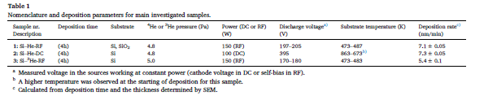
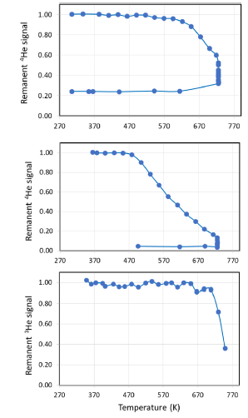
Table 1 Nomenclature and deposition parameters for main investigated samples. Sample nr. Description Deposition time Substrate 4He or 3He pressure (Pa) Power (DC or RF) (W) Discharge voltagea) (V) Substrate temperature (K) Deposition ratec) (nm/min) 1: Si–He-RF (4h) Si, SiO2 4.8 150 (RF) 197–205 473–487 7.1 ± 0.05 2: Si–He-DC (4h) Si 4.8 100 (DC) 395 863–673b) 7.3 ± 0.05 3: Si–3He-RF (4h) Si 5.0 150 (RF) 170–180 473–483 5.4 ± 0.1 a Measured voltage in the sources working at constant power (cathode voltage in DC or self-bias in RF). b A higher temperature was observed at the starting of deposition for this sample. c Calculated from deposition time and the thickness determined by SEM.
Low gas consumption fabrication of 3He solid targets for nuclear reactions
Materials & Design
2020-01 | Journal article
DOI: 10.1016/j.matdes.2019.108337
Contributors: Asunción Fernández; Dirk Hufschmidt; Julien L. Colaux; Jose Javier Valiente-Dobón; Vanda Godinho; Maria C. Jiménez de Haro; David Feria; Andrés Gadea; Stéphane Lucas

